Slide 1
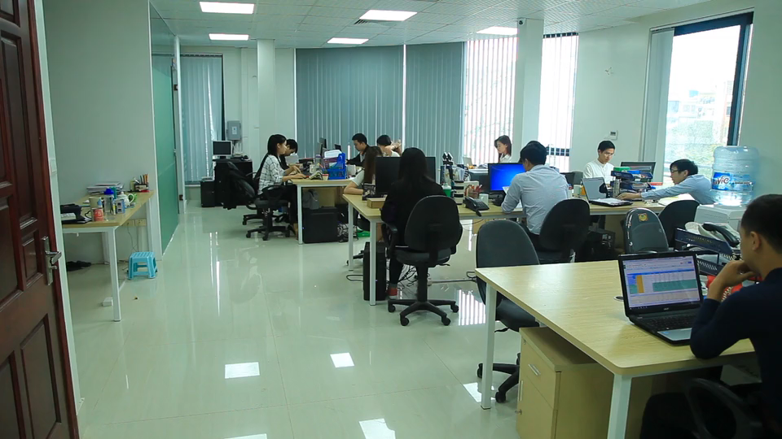
職場故事 (Animaze)
Notes:
https://pixabay.com/videos/girl-office-w-computer-work-27091/

Slide 2
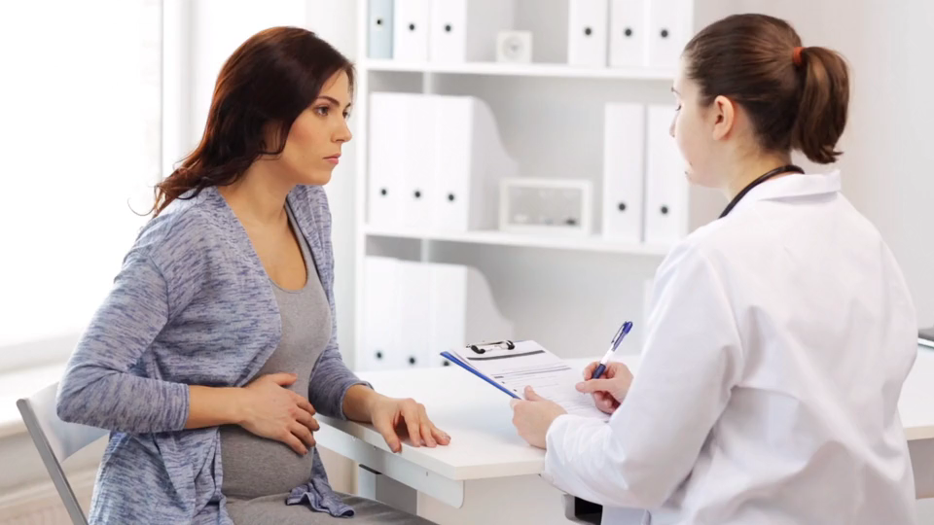
目標
Notes:
https://pixabay.com/videos/pregnancy-gynecologist-medicine-49816/

Slide 3
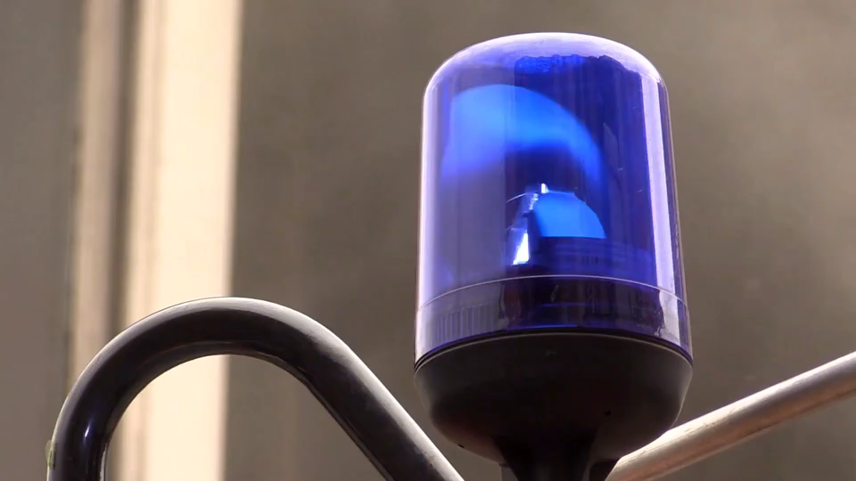
Notes:
https://pixabay.com/videos/blue-light-fire-fighters-mission-7013/

Slide 4
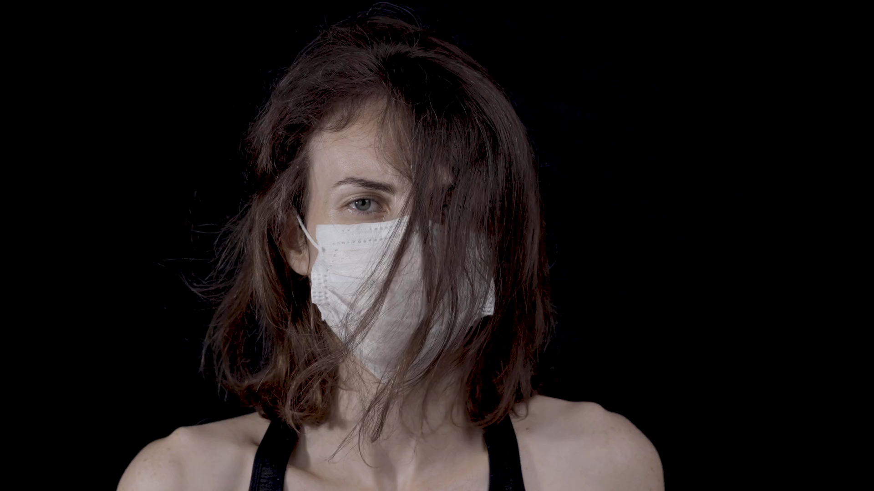
阻礙
Notes:
https://pixabay.com/videos/coronavirus-quarantine-mask-woman-44638/

Slide 5
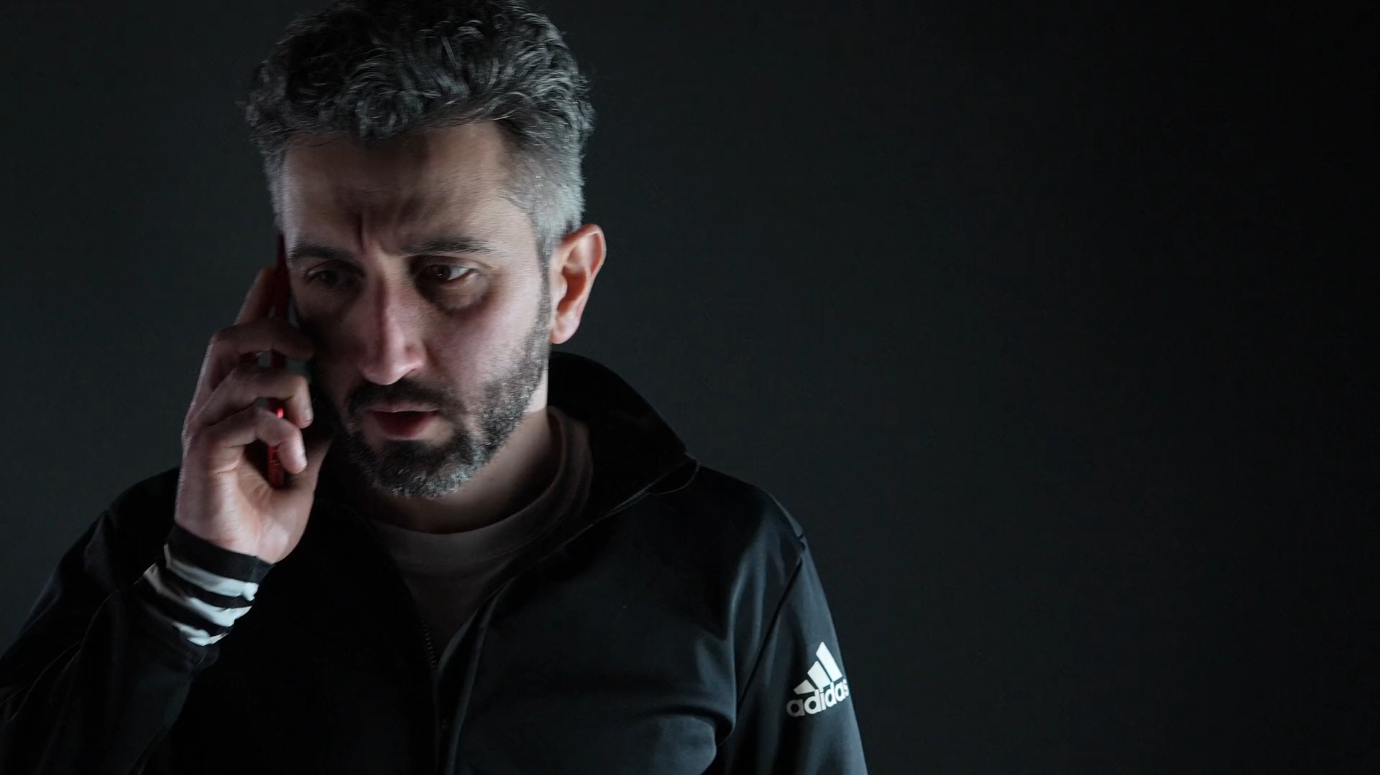
Notes:
https://pixabay.com/videos/man-call-smartphone-anger-to-speak-204421/

Slide 6
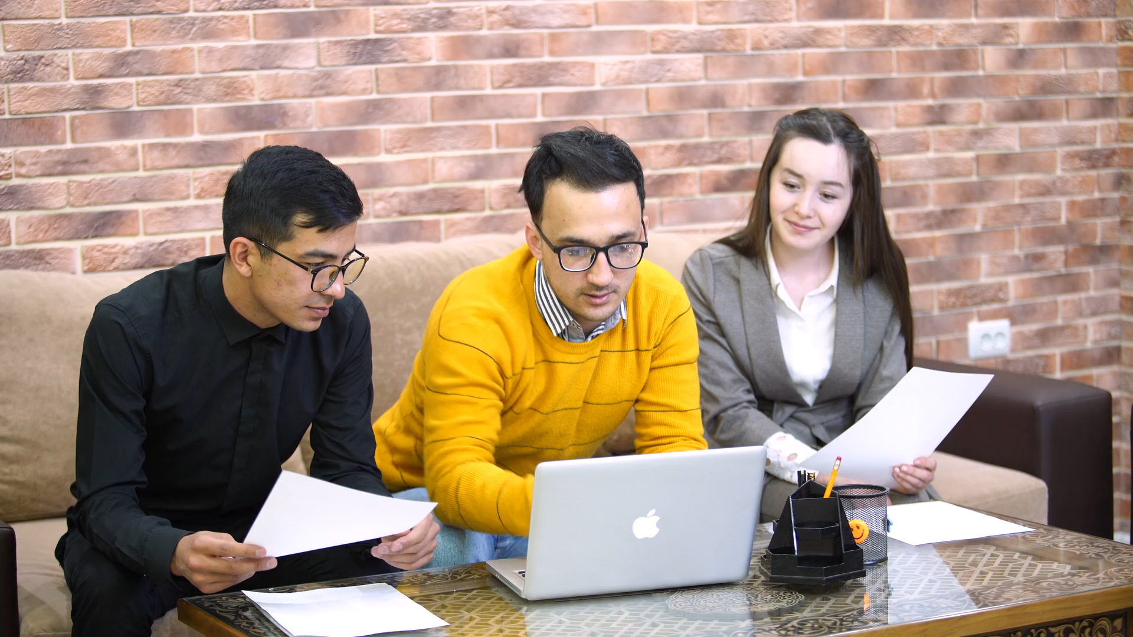
努力
Notes:
https://pixabay.com/videos/work-office-people-working-87593/

Slide 7
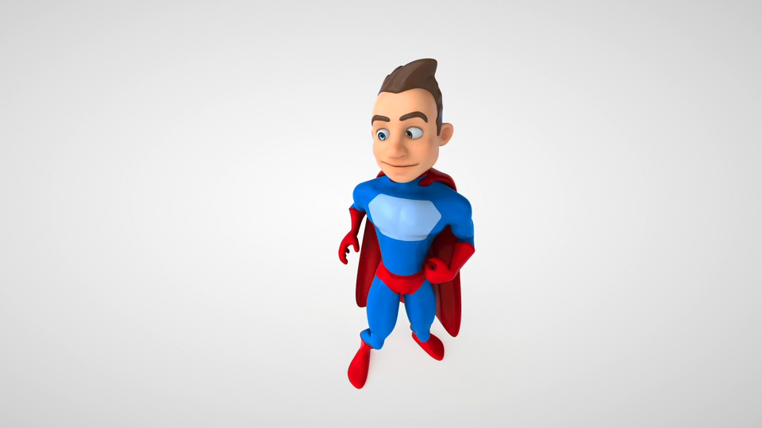
Notes:
https://pixabay.com/videos/superhero-cartoon-3d-super-hero-38043/

Slide 8
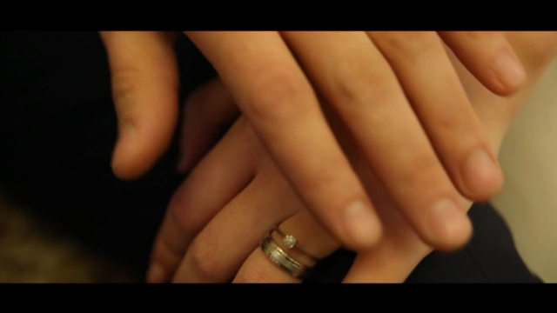
結果
Notes:
https://pixabay.com/videos/hands-support-marriage-love-552/

Slide 9
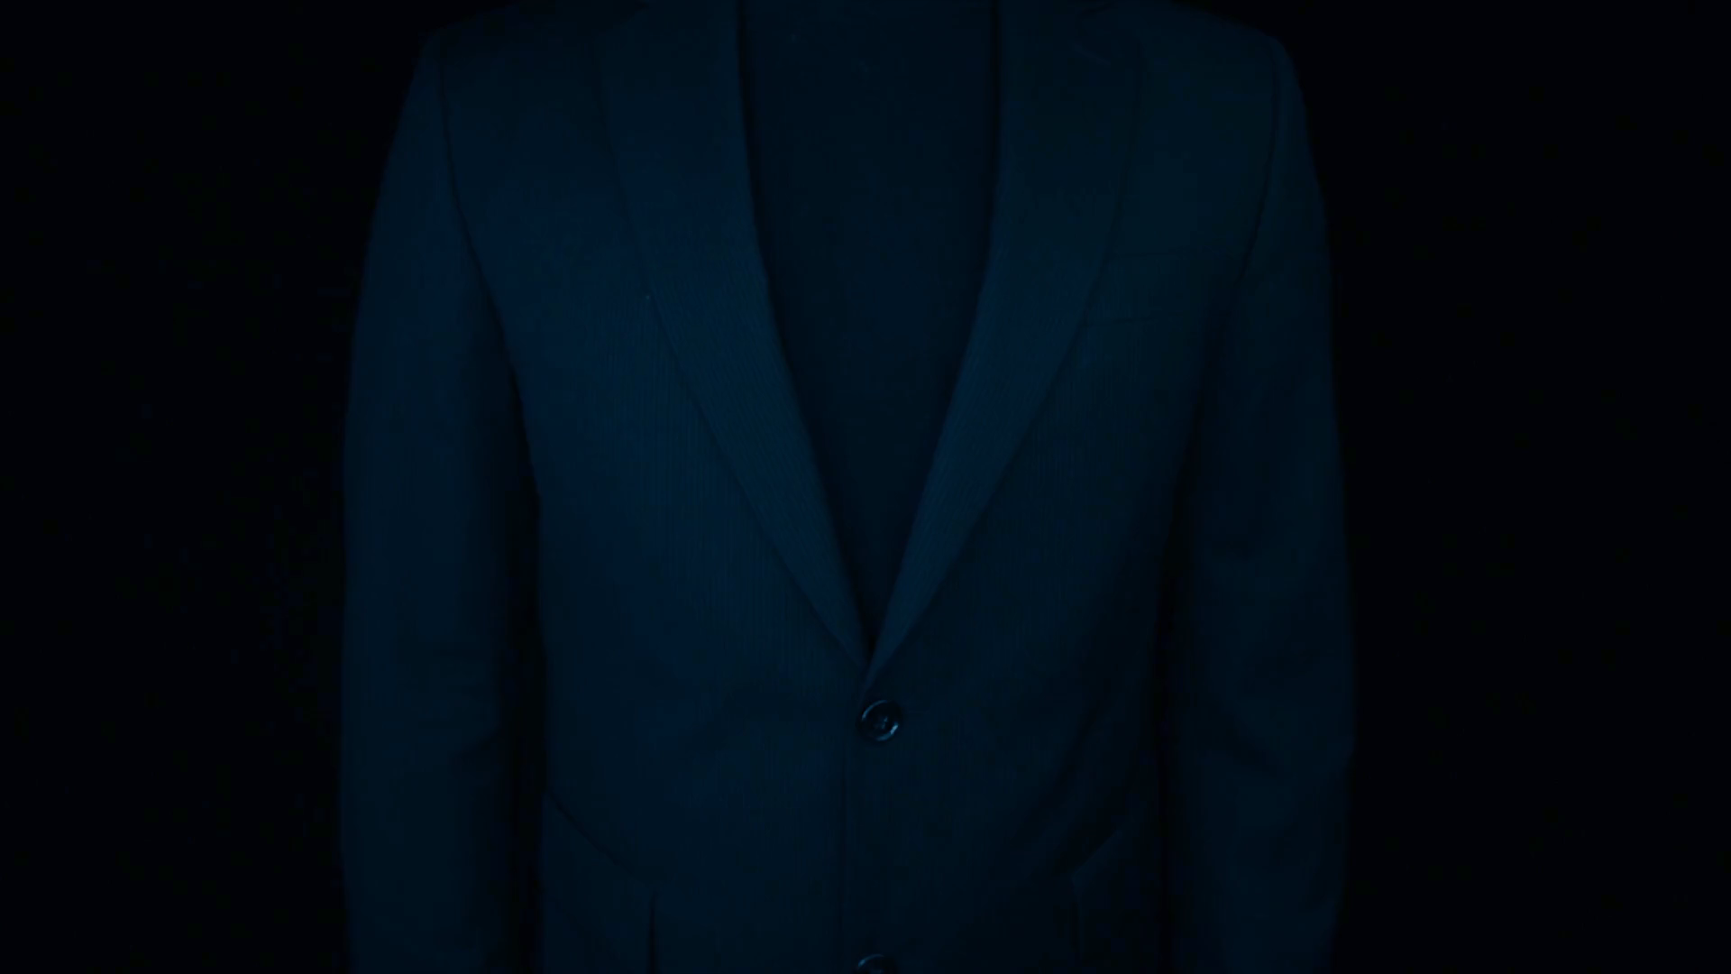
意外
Notes:
https://pixabay.com/videos/hands-help-person-caregiver-63115/

Slide 10
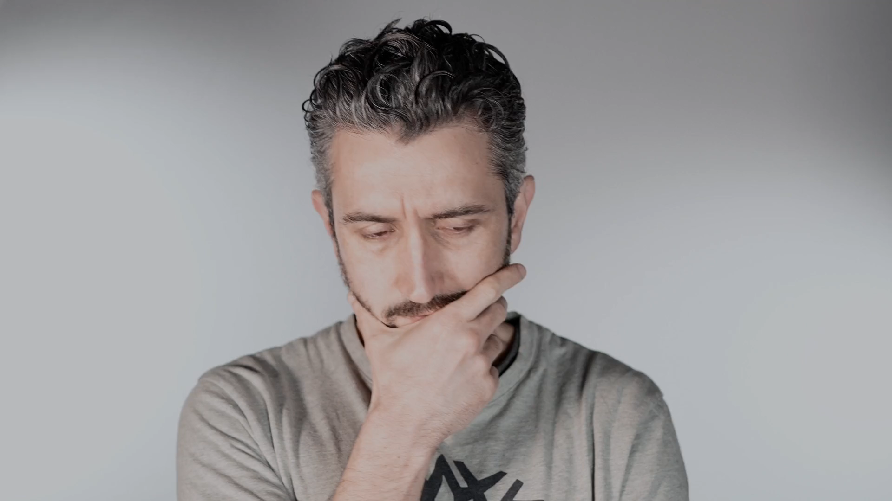
Notes:
https://pixabay.com/videos/man-think-beard-thoughtful-203251/

Slide 11
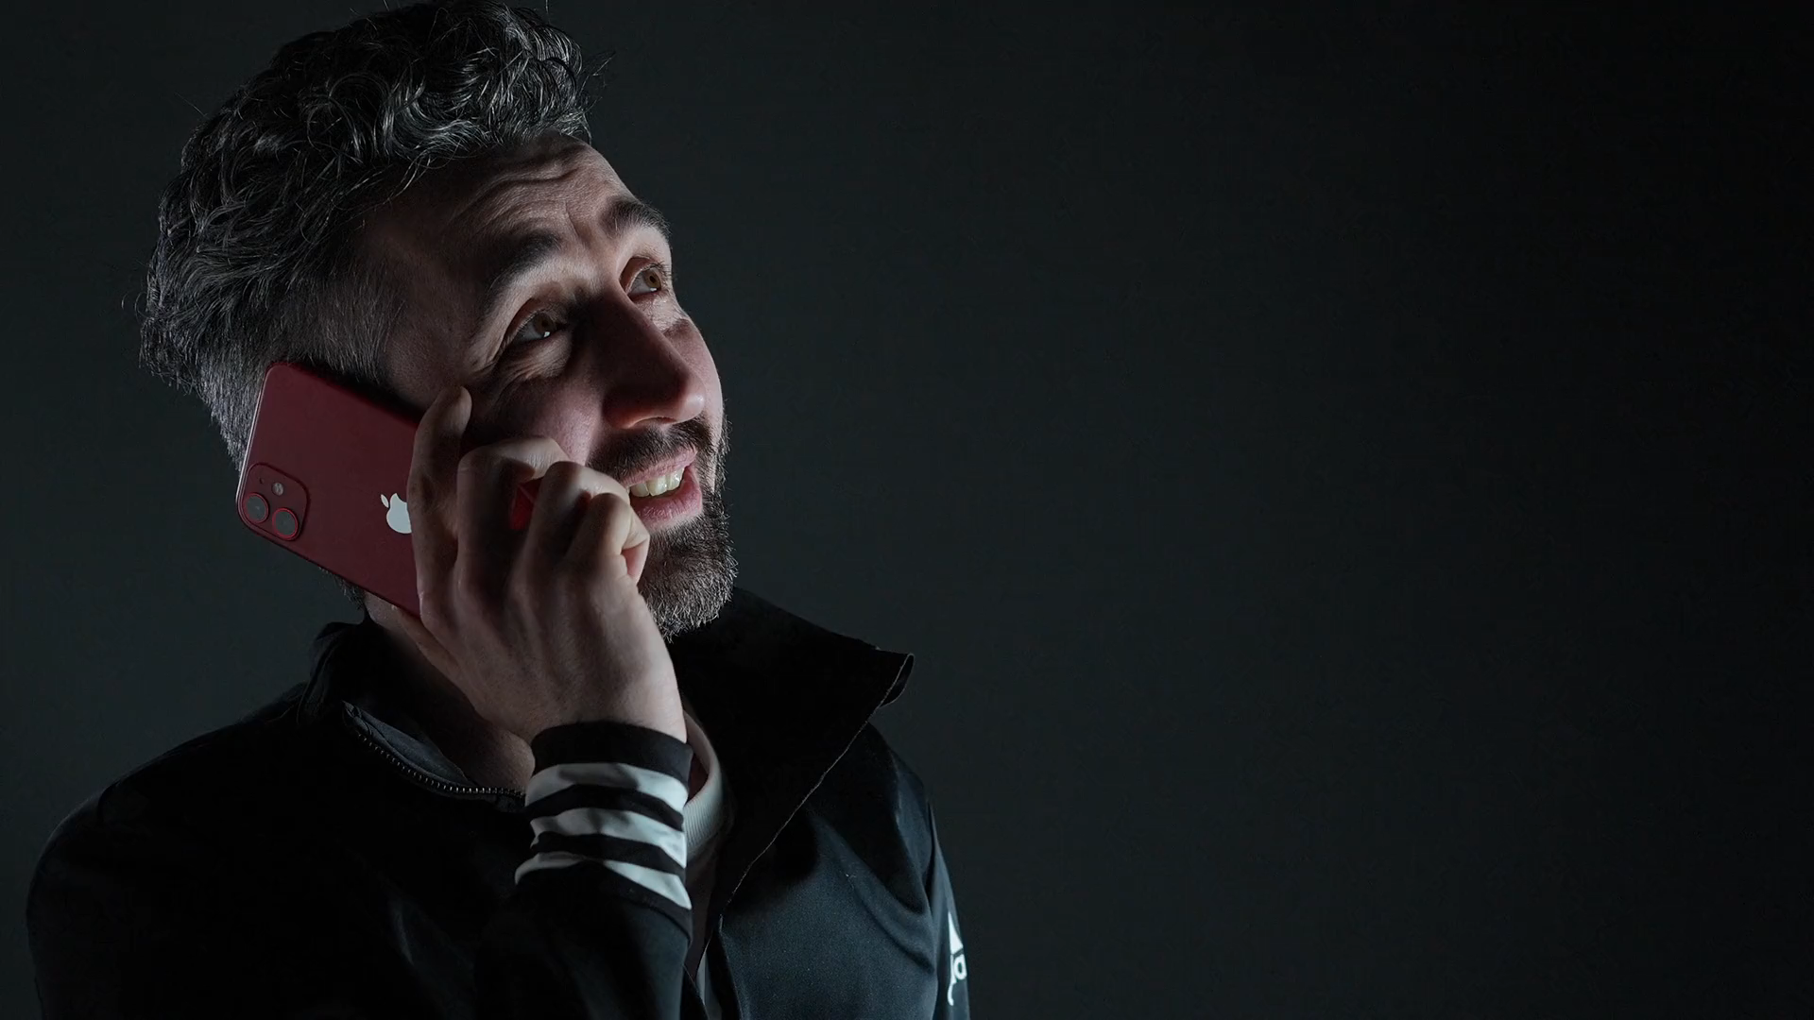
轉彎
Notes:
https://pixabay.com/videos/man-call-happy-to-speak-laugh-204420/

Slide 12
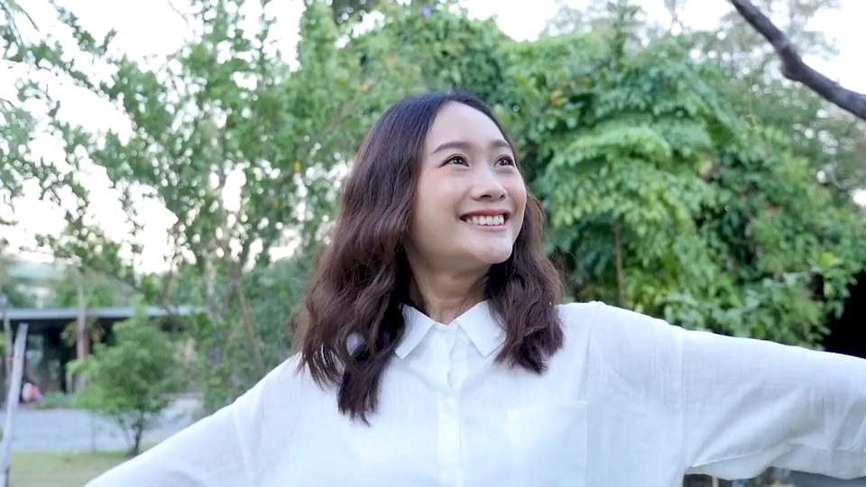
結局
結局
Notes:
https://pixabay.com/videos/woman-smile-joy-happinness-park-83860/

